Slide 1

Presentation for the Bank Customer Churn Prediction
By
Young Jin Jang

Slide 2
Contents
Background of the data
KNN model
KNN model with the GridSearchCV
Random Forest
Random Forest with the GridSearchCV
Final Recommendation

Slide 3
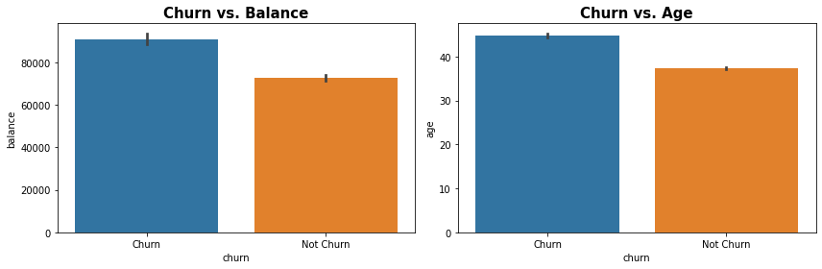
Background of The Data
The task is to predict whether a bank customer will 'churn' or close their account. I think there has strong correlation between the target and the columns of Balance and Age
For the Churn vs Balance plot, it tells that Customer Churn has more average balance than who does not Customer Churn. This might be affected to the bank if they close their accounts. Therefore, the bank need to find a way to hold those Customer Churn.
For the Churn vs Age plot, it tells that the average age of the Customer Chun is higher than the average age of the Customer Chun. I think some people close the account when they are approximately 40. Therefore, the bank need to focus on making new customers.

Slide 4
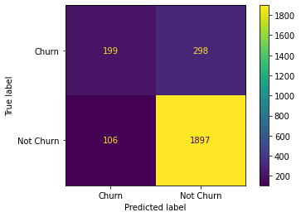
KNN model
2,500 accounts were tested for the Bank Customer Churn Prediction
The classifier of KNN model predicted 2,003 accounts to have tested positive and the rest 497 as negative.
However, 2,195 accounts tested positive and 305 tested negative.

Slide 5
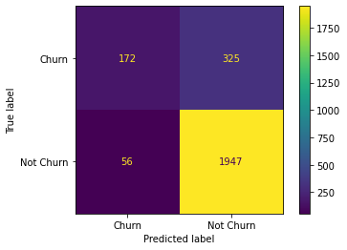
KNN model with the GridSearchCV
2,500 accounts were tested for the Bank Customer Churn Prediction
The classifier of KNN model predicted 2,003 accounts to have tested positive and the rest 497 as negative.
However, 2,272 accounts tested positive and 228 tested negative.

Slide 6
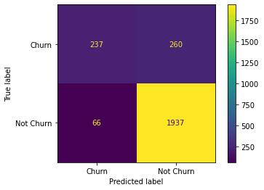
Random Forest
2,500 accounts were tested for the Bank Customer Churn Prediction
The classifier of KNN model predicted 2,003 accounts to have tested positive and the rest 497 as negative.
However, 2,197 accounts tested positive and 303 tested negative.

Slide 7

Random Forest with the GridSearchCV
2,500 accounts were tested for the Bank Customer Churn Prediction
The classifier of KNN model predicted 2,003 accounts to have tested positive and the rest 497 as negative.
However, 2,201 accounts tested positive and 299 tested negative.

Slide 8
Final Recommendation
I will choose the KNN with the GridSearchCV model because there has less errors when I compared with other confusion matrixes.
Confusion matrix for the KNN with the GridSearchCV shows 56 errors in the total, but other confusion matrix shows more error than KNN with the GridSearchCV.
True Negative is better than True Positive at predicting in the confusion matrix for the KNN with the GridSearchCV

Slide 9
Thank You
-THE END-

